Slide 1



Introducing the FEC

Slide 2
Our Partners
Cities for Financial Empowerment Fund
City of Pittsburgh
Neighborhood Allies
Advantage Credit Counseling Service, Inc.

Slide 3
Core Elements of the FEC Model
The Financial Empowerment Center initiative provides free, one-on-one financial counseling as a public service to all residents.
Free
One-on-One
Professional
Integrated
Data Driven
Government-Branded
Sustainable

Slide 4




Four Core Outcomes of the FEC
The goal of the program is to help Pittsburgh community residents manage their finances by focusing on four outcomes:
Open and utilize safe, affordable banking services
Build savings and better saving habits
Savings
Decrease debt
Establish and build credit

Slide 5

FEC Impact to Date
82,000 clients served
$100 million in debt reduced
$10 million in savings achieved
Operating in 11 cities: New York City, Lansing, Nashville, Denver, Philadelphia, San Antonio, Akron; Pittsburgh, Akron, Greenville, Memphis

Slide 6

Our Locations
ACCS (Southside)
CoLab18 (Northside)
PA Careerlink (Downtown)
Reemployment Transition Center, Allegheny County EARN (Downtown)
Homewood-Brushton YMCA
Focus on Renewal (McKees Rocks)
Pittsburgh Community Services, Inc. (Oakland)
West End Library
Warrington Rec Center (Beltzhoover)
Carrick Library

Slide 7
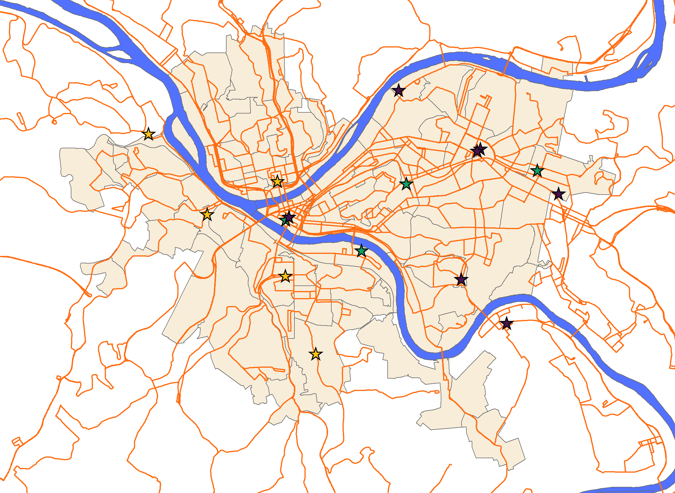
Our Locations

Slide 8
FEC Services
FEC Staff Can Provide In-House:
Money management & budgeting skills
Education on banking & financial products
Pull and review credit report
Guidance on responsible credit use
Education on consumer rights (debt collection, student loans, bankruptcy, etc.)
Planning for retirement
Advisement on saving for home ownership & mortgages
Referrals to other community providers
FEC Staff can Refer Clients to Organizations that:
Provide legal advice or legal services
Assist with filing taxes
Offer financial or emergency assistance

Slide 9
Who Can Come to the FEC for Services?
Anyone living in the Pittsburgh area!
NOTE: You DO NOT need to live within the Pittsburgh city limits, but must be willing to travel to one of our FEC locations for an appointment
Any individual looking to talk through a financial issue or learn better money management skills
Must be 18+ to receive free counseling
BUT we are available to lead group workshops for youth

Slide 10
How to Refer a Client to the FEC
Call us! 1-800-298-0237
Email us! fecinfo@advantageccs.org
Fill out our FEC Partner Referral Form
Completed forms can be emailed to FEC Program Manager Rebecca Johnson (rjohnson@advantageccs.org)

Slide 11

Other ways we can help:
Community-Based Workshops
Tabling Events
Trainings for Staff
Partner Feedback:
What’s working?
What else do you need?
Any Questions?

Slide 12


CONTACT US!
1-800-298-0237
fecinfo@advantageccs.org
Know someone who could benefit from FREE financial counseling?

